Slide 1
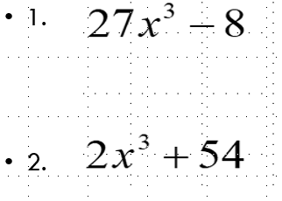
Thursday’s Sponge! Factor each!

Slide 2
Sponge check
1.
2.

Slide 3
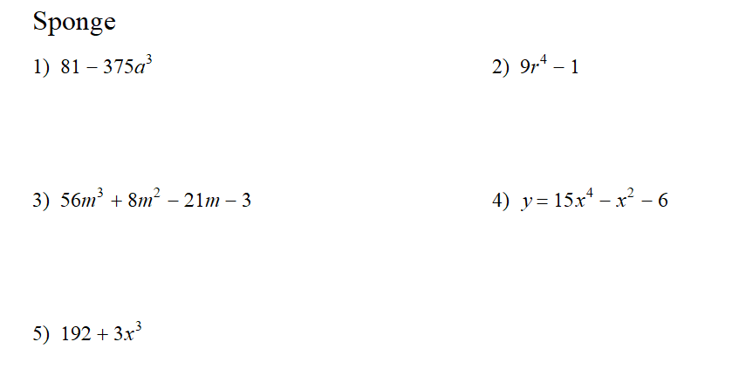
Sit for now. I will re-arrange seats after the quiz. Factor each completely!

Slide 6
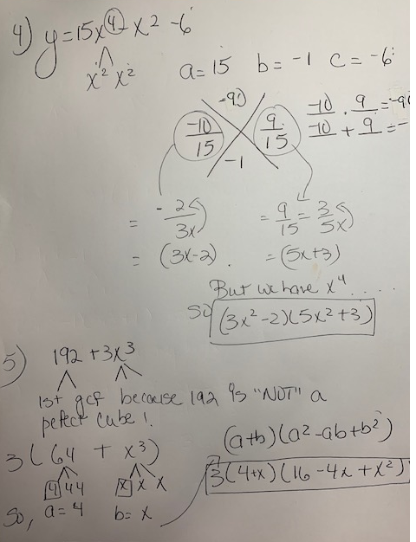

Slide 8
Formulas Turn quiz in drawer. CW handout on my desk.
$$a^{3}+b^{3}={\left(a+b\right)(a}^{2}−ab+b^{2})$$
$a^{3}−b^{3}={\left(a−b\right)(a}^{2}+ab+b^{2}$)

Slide 9
Monday’s Sponge (Use synthetic division to divide.)
1. x⁴ – 10x² – 2x + 4 by (x + 3)
$${2. x}^{4}−8x^{2}+16 ÷(x+2)$$

Slide 10
Review #1: Use Synthetic Division to divide
x⁴ – 10x² – 2x + 4 by (x + 3)
-3
1
0
-10
-2
4
-3
9
3
-3
1
-3
-1
1
1
remainder

Slide 11
#2 Check! Your turn. $x^{4}−8x^{2}+16 ÷(x+2)$

Slide 12
Finding solutions! A little review! White boards please! Partner up!
Solve each!
Example #1

Slide 13
Example 2

Slide 14
Example 2

Slide 15
Example 3

Slide 16
Example 3

Slide 17
Example 4

Slide 18
#4 Work shown!

Slide 19
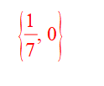
Example 5

Slide 20
Check! Example 5

Slide 21
Example 6

Slide 22
Check #6

Slide 23
Example 7

Slide 24
Example 7

Slide 25
Example 8

Slide 26
Example 9

Slide 27
Example 10

Slide 28
Check Example 10

Slide 29
Unit 3 Continued Essential Question: How do I use the Remainder& Factor Theorem with synthetic division to find All of the zeros?

Slide 30
Goals!!! Copy…
Goal 1: Find the remainder.
How? Use long division or synthetic division. (Recall that the last number using synthetic division is your remainder!)
Goal 2: Determine if what we are given is a factor or not! Or if what’s given is a root!
How? If the remainder is zero = YES !! If the remainder ≠ 0, then No.

Slide 31
What are the “Remainder & Factor Theorems”?
Remainder Theorem:
If f(x) is synthetically divided by “k” then f(k) = R where R is the Remainder.
Factor Theorem :
If remainder = 0 and we substitute in a # “or” root, into some function, then (x – #) is a factor.
Now that’s a lot!! What does it really mean?

Slide 32
REMAINDER THEOREM
Example 1: Find the remainder using synthetic division by dividing. (Divide)
$$f\left(x\right)=2x^{3}−3x^{2}+2x−1 by \text{(}\text{x}\text{+2).}$$
The root of (x + 2)
is x = -2
-2 2 -3 2 -1
Using synthetic division let’s divide by x + 2
-4 14 -32
2 -7 16 -33
Note: The remainder we know from U2 is -33!!
Now, Find f(-2) using substitution.
So the remainder we get in synthetic division is the same as the answer we’d get if we put -2 in the function.

Slide 33
Ex. 2
$$Find the remainder of f\left(x\right)={3x}^{5}−{5x}^{3}+57$$
$when divided by (x+2)$. Use synthetic division.
Conclusion: This tells us (x+2) is not a factor b/c the remainder does not equal “zero”.
So we know from Unit 2 Remainder = 1

Slide 34
Must remember!
If I give you a factor ( x-9), you must switch the sign for synthetic division and substitution!
IF you’re given f(8), you use 8, not (-8).

Slide 35
Ex2.
${Given f\left(x\right)=x}^{4}−6x^{3}+{8x}^{2}+5x+13$find f(4).
$$State the remainder and what does it tells us?$$

Slide 36
Check! Ex2. By SYNTHETIC DIVISION
${Given f\left(x\right)=x}^{4}−6x^{3}+{8x}^{2}+5x+13$find f(4)
$$find the remainder and what does it tells us?$$

Slide 37
Check! Ex2. By SYNTHETIC DIVISION
${Given f\left(x\right)=x}^{4}−6x^{3}+{8x}^{2}+5x+13$find f(4)
$$find the remainder and what does it tells us?$$

Slide 38
Ex2. Using “ SUBSTITUTION”
${Given f\left(x\right)=x}^{4}−6x^{3}+{8x}^{2}+5x+13$find f(4)
$$find the remainder and what does it tells us?$$

Slide 39
$${Ex3. x}^{3}+5x^{2}−12x−36$$ Is (x-3) a factor of the polynomial ? Yes or No?? You choose the method!
Hint: Use synthetic division or substitute f(3)!
Now since the remainder = 0, this says that ( x-3) is a factor of the polynomial. Use previous knowledge to solve the polynomial ! KEEP GOING!!
${1x}^{2}+8x+12$=0 Factor and solve!

Slide 40
HW Even only! Recap
We could get a remainder using long division or synthetic division
The last number using synthetic division is your remainder!
A remainder tells us if we have a factor or not!
Goal2: We want a remainder of 0 to find the other roots…and we want to be able to find other roots!

Slide 41
(Tuesday’s ) Turn in HW please. SPONGE Find all factors and zeros! You‘re given a potential factor for #’s 1&2.
F(x) = x³ + 5x² – 9x – 45 ; (x – 3)
F(x)=x³ – 5x² – 4x + 20 ; (x + 2)
Solve $x^{3}+7x =−{2x}^{2}−14$
Use long division to divide
(4x³ + 5x² – 23x – 6)÷ (4x + 1)

Slide 42
Check 1! F(x) = x³ + 5x² – 9x – 45 ; (x – 3)

Slide 43
Check 2! F(x)=x³ – 5x² – 4x + 20 ; (x + 2)

Slide 44
Check 3! Solve $x^{3}+7x =−{2x}^{2}−14$

Slide 45
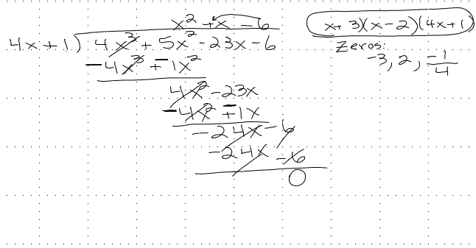
Check 4!
(4x³ + 5x² – 23x – 6)÷ (4x + 1)

Slide 46
Review of Long Division!

Slide 47
Review #2

Slide 48
Review #3 “Long Division”

Slide 49
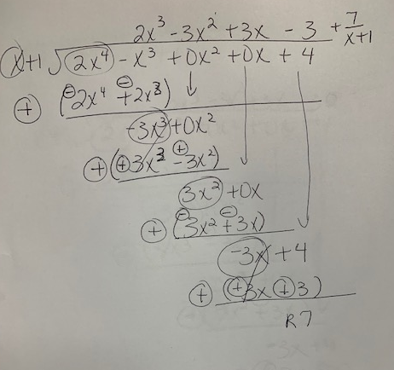

Slide 50
#4 Write a polynomial function of least degree with integral coefficients that has the given zeros. X= $5,−2, \frac{2}{3}$

Slide 51
Long Division Instructional Video
http://cms.gavirtualschool.org/Shared/Math/GSEAdvancedAlgebra/OperationsWithPolynomials/GSEAdvancedAlgebra_OperationswithPolynomials_Shared2.html#

Slide 52
Practice 1. Determine whether (x + 2) is a factor of f(x) = 3x³ - x² + 2x – 4
(Use substitution).
Answer:
NO

Slide 53
Practice 2 (Use Synthetic Division)
Determine whether (x - 6) is a factor of
f(x) = x⁴ - 6x³ - 4x + 24

Slide 54
Check Practice 2
Determine whether (x - 6) is a factor of
f(x) = x⁴ - 6x³ - 4x + 24

Slide 55
Practice 3 (Use synthetic division!)
IS (x-10) is a factor of
Yes. Now keep going to solve it.

Slide 56
Practice 3- Part 2: Find all zeros!
SYNTHETIC DIVISION!!
Therefore the $Factors=(x−10)(x−4)(x+2)$
What are the roots?

Slide 57
No!!! Try again! Is (x-1) is a factor of g(x) = 3x³ + 8x² – 3x – 8
If so find all the other factors and roots.
1
3
8
-3
-8
3
11
8
3
11
8
0 = remainder, so (x-1) is a factor)
3x²
+11x
+8
Now FACTOR what’s left from Synthetic Division!
FACTORS:
What are the roots? X = 1, -1, -8/3

Slide 58
Example 5 Find all factors and zeros!
Must use Synthetic Division.
F(x) = x³ + 5x² – 9x – 45; x – 3

Slide 59
CHECK 5
F(x) = x³ + 5x² – 9x – 45; x – 3

Slide 60
Example 6 Find all factors and zeros! Must use Synthetic Division.
x³ – 5x² – 4x + 20; x + 2

Slide 61
CHECK 6
x³ – 5x² – 4x + 20; x + 2

Slide 62
Example 7! Find all factors and zeros! (2x⁴ –5x³ +16x-40 ) ÷ ( 2x -5)

Slide 63
(2x⁴ –5x³ +16x-40 ) ÷ ( 2x -5)

Slide 65
HW, Unit Packets Pages 7&9 (Even only), Page 8 – all

Slide 66
Ex8: Use long division to divide (3x⁴ +x³ -3x-1) ÷ ( 3x +1)

Slide 67
Check 8! (3x⁴ +x³ -3x-1) ÷ ( 3x +1)

Slide 68
Copy HOW DO YOU FACTOR USING LONG DIVISION?
Divide by the given factor using Long division (ax + k) ex. (2x+5), (3x-1)
Then, factor the quotient for remaining factors.
Write your factors in the form and then solve:
(x – a)(x – b)(ax + b)
Find its zeros : x = a, b, ^{–b}/_{a} (You get the zeros by simply setting each factor equal to zero and solve for x)

Slide 69
Wednesday’s Sponge
How many zeros will this function have? $f\left(x\right)=−4x^{5}+15x^{3}−x$
Write a polynomial function of least degree with integral coefficients that has the given zeros. $3,−5, \frac{4}{3}$
${Solve 8x}^{3}−2x=0$

Slide 70
What is the Rational Root Theorem and when do we know to use it?
The Rational Root Theorem gives us a tool to “predict” the Values of the rational roots!
When do we know to use it?
When you are not given a “zero or factor” and/or grouping with 4 terms does not work!

Slide 71
How to use “The Rational Root Theorem”? COPY:
1st Form a ratio of : + $\frac{ ( p)}{ ( q)}$= + $\frac{ (factors of p)}{ (factors of q)}$
**where is the p (constant term) & q is the (leading coef.)**
2ndCreate list of “all” possible factors + $\frac{ ( p)}{ ( q)}$
3rd Use substitution/synthetic division on any possible factor/s to get a remainder of zero!
4th Factor and/or solve the remaining.

Slide 72
Graphic Organizers!
Step 1 (Observe) ${f\left(x\right)=x}^{3}−3x^{2}+5x−15$
Step 2What is p: (constant) _____
Factors of p ±____________________
What is q? (leading coeff) ______
Factors of q ± __________________________
All possible roots $\frac{p}{q}\text{= }\text{±}______________________________$

Slide 74
Steps 3 & 4 Next try a potential “root” from the list! Recall: We need a remainder of Zero! ${f\left(x\right)=x}^{3}−3x^{2}+5x −15$ $$\frac{p}{q}=±1,3,5,15$$
NO!
Okay! Try 1 for synthetic division or substitution.
Okay! Let’s try 3 for synthetic division or substitution. !
Yes! So…now find all factors and zeros!

Slide 75
Copy~ Ex.2 $x^{3}−{4x}^{2}−11x+30$
1st we list all “possible Rational Roots” because we were not given a factor nor zero!
What is p: (constant) _____
Factors of p ± ____________________
What is q? (leading coeff) ______
Factors of q ±__________________________
All possible roots $\frac{p}{q}=\text{±} ______________________________$

Slide 76
Ex2 Continued… Now we pick a possible root to try! Hopefully we’ll get a remainder of zero on the 1st attempt !! ☺
Ex.2 $x^{3}−{4x}^{2}−11x+30$

Slide 77
Ex3 Your turn! Please copy the correct problem below. Instructional Video (Check and Follow along..) https://www.youtube.com/watch?v=Iaq7z7reznM&feature=youtu.be
$f\left(x\right)=x^{3}+{2x}^{2}−5x−6$
What is p: (constant) _____
Factors of p ± ____________________
What is q? (leading coeff) ______
Factors of q ±__________________________
All possible roots $\frac{p}{q}=\text{±} ______________________________$

Slide 78
Your turn ! Ex.4 $x^{3}+8x^{2}+11x−20$
List all rational roots, then find all factors and zeros.

Slide 79
(Main idea…) Exit Ticket (Show me your completed #4 for your Exit ticket.
Please complete the following phrase on the ½ sheet.
When you are not given a root or a zero you must ________________________________.

Slide 80
Your turn again! Ex.4 $x^{3}+8x^{2}+11x−20$
List all rational roots, then find all factors and zeros.

Slide 81
F(x)= x³ – x² -9x + 9

Slide 82
Check!

Slide 83
Using the Rational Root Theorem with a “quartic polynomial”?
List the Rational Zeros: + ^{p}/_{q}
Use synthetic division and get the first result ($x^{3}$)
Repeat synthetic division with your 1st result choosing a different “possible” to get ($x^{2}$).
Then solve.
(Note: Must find 2 that works so that you get it “down’ to a quadratic).

Slide 84
Ex1. f(x) = x⁴ – 10x² + 9
List the rational zeros. Find the real zeros

Slide 85
Check! f(x) = x⁴ – 10x² + 9
List the rational zeros. Find the real zeros

Slide 86
Ex2. f(x) = x⁴ – 5x² + 4

Slide 87
Check! Ex2. f(x) = x⁴ – 5x² + 4
List the rational zeros & find the real zeros

Slide 89
$$Your turn! \\ f\left(x\right)=x^{4}+{x^{3}−11x}^{2}−9x+18$$

Slide 90
Check!
$$f\left(x\right)=x^{4}+{x^{3}−11x}^{2}−9x+18$$

Slide 91
Check continued

Slide 92
You try! Example 2 $$\left(f(x\right)={5x}^{4}−46{x^{3}+84x}^{2}−50x+7=0$$

Slide 93
Extra problems after this slide!!!!

Slide 94
f(x) = x³ + 9x² + 23x + 15
List the rational zeros. Factor & Find the zeros

Slide 95
f(x) = 2x³ – x² – 15x + 18
List the rational zeros. Factor & Find the zeros

Slide 96
f(x) = 5x³ + 9x² – 6x – 8
List the rational zeros. Factor & Find the zeros

Slide 97
Ex3. Given that (x-2) and (x+3) are factors of
$$f(x)=2x^{4}+7x^{3}−4x^{2}−27x−18$$
Find the remaining factors.
2
2
7
-4
-27
-18
4
22
36
18
(x-2) is a factor NOW USE the result to do synthetic again to check for the 2nd factor!
-3
2
11
18
9
0
-6
-15
-9
2
5
3
0
(x+3) is also a factor. Now factor ${2x}^{2}+5x+3$

Slide 98
Check
$x^{4}+{6x}^{3}+x^{2}−24x−20$
$$\left(x−2\right)and \left(x+5\right)are factors$$

Slide 99
Check

