Slide 1
Something New-
Do you know how to multiply ?
What about

Slide 2
Sponge (COPY EACH. Then classify each by degree and term.)
F(x) = -5 + 2x² + 3x
F(x) = 4 – 3x + 3
F(x) = 3x + 5 – 3x² + x³
F(x) = 5 - 5x⁴
F(x) = 6x⁵y

Slide 3
Binomial Theorem and Pascal’s Triangle

Slide 4
2
3
3
4
6
4
1
adding

Slide 5
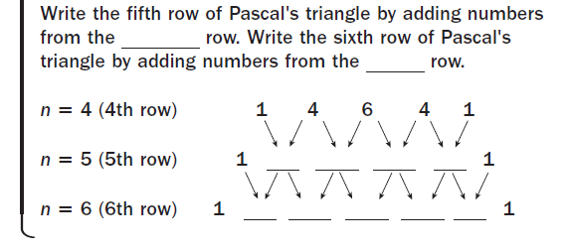
4th
5th
5
10
10
5
6
15
20
15
6
Now you complete the 7th row!

Slide 7
1 4 6 4 1
x⁴ + x³ + x² + x + x⁰
y⁰ y¹ y² y³ y⁴

Slide 8
Use the Binomial Theorem and Pascal’s
Triangle to write each binomial expansion.
Ex. 5
1 2 1

Slide 9
Ex. 6
1 4 6 4 1

Slide 10
Ex. 7 - You Try!
*You will get
larger #s!

Slide 11
Ex. 8 – Last One!

Slide 12
EXTRRASSSSSS

Slide 13
COPY Separate Sheet of paper!
Practice #1! Adding Polynomials
Add.
(6x² – 4y) + (3x² + 3y – 8x² – 2y)
(6x² – 4y) + (3x² + 3y – 8x² – 2y)
Identify like terms.
Group like terms together within each polynomial.
(6x² + 3x² – 8x²) + (3y – 4y – 2y)
6x² – 4y
Use the vertical method.
+ –5x² + y
Combine like terms.
x² – 3y
Simplify.

Slide 14
PRACTICE #2
Add (5a³ + 3a² – 6a + 12a²) + (7a³ – 10a).
(5a³ + 3a² – 6a + 12a²) + (7a³ – 10a)
Identify like terms.
(5a³ + 7a³) + (3a² + 12a²) + (–10a – 6a)
Group like terms together.
12a³ + 15a² – 16a
Combine like terms.

Slide 15
COPY Separate Sheet of paper!
Practice #1! Adding Polynomials
Add.
(6x² – 4y) + (3x² + 3y – 8x² – 2y)
(6x² – 4y) + (3x² + 3y – 8x² – 2y)
Identify like terms.
Group like terms together within each polynomial.
(6x² + 3x² – 8x²) + (3y – 4y – 2y)
6x² – 4y
Use the vertical method.
+ –5x² + y
Combine like terms.
x² – 3y
Simplify.

Slide 16
PRACTICE #1
Add (5a³ + 3a² – 6a + 12a²) + (7a³ – 10a).
(5a³ + 3a² – 6a + 12a²) + (7a³ – 10a)
Identify like terms.
(5a³ + 7a³) + (3a² + 12a²) + (–10a – 6a)
Group like terms together.
12a³ + 15a² – 16a
Combine like terms.

Slide 17
RECAP #2
Subtracting Polynomials
Subtract.
(–10x² – 3x + 7) – (x² – 9)
(–10x² – 3x + 7) + (–x² + 9)
Rewrite subtraction as addition of the opposite.
(–10x² – 3x + 7) + (–x² + 9)
Identify like terms.
–10x² – 3x + 7
Use the vertical method.
–x² + 0x + 9
Write 0x as a placeholder.
–11x² – 3x + 16
Combine like terms.

Slide 18
#3
Subtract.
(9q² – 3q) – (q² – 5)
(9q² – 3q) + (–q² + 5)
Rewrite subtraction as addition of the opposite.
(9q² – 3q) + (–q² + 5)
Identify like terms.
Use the vertical method.
9q² – 3q + 0
Write 0 and 0q as placeholders.
+ − q² – 0q + 5
8q² – 3q + 5
Combine like terms.

Slide 19
Subtract.
(2x² – 3x² + 1) – (x² + x + 1)
(2x² – 3x² + 1) + (–x² – x – 1)
Rewrite subtraction as addition of the opposite.
(2x² – 3x² + 1) + (–x² – x – 1)
Identify like terms.
–x² + 0x + 1
Use the vertical method.
+ –x² – x – 1
Write 0x as a placeholder.
–2x² – x
Combine like terms.

Slide 20
QUESTIONS???

