Slide 1
SPONGE - Take one off of the desk up front and begin! It’s a mathematics vocabulary puzzle.☺ Work together to complete as many as you can…THINK HARD! ☺

Slide 3
Unit 2 Functions
Essential Questions
How do I name polynomials?
How do I add and subtract polynomials?
How do I multiply polynomials?

Slide 4
Graphic Organizers unction:
A polynomial function is a monomial or the sum of monomials with all exponents as whole numbers (not negative ) and coefficients are all real numbers.
Ex-
x³+6x²+12x+8

Slide 5
Are all the exponents written as whole numbers? Are all coefficients real numbers.
YES
a)
NO
b)
c)
NO
YES
d)

Slide 6
STANDARD FORM
The terms of a polynomial are in STANDARD FORM when:
they are ordered from left to right in ______________ order; which means from the ____________ exponent to the ____________
decreasing
largest
smallest

Slide 7
DEGREE:
The _________exponent in the polynomial. It determines the _____________________.
largest
Number of Zeros
2
Ex: The degree of –7x + 9 – 4x² is ____.
(Copy below.)
Classifying “By Degree”
x⁰ x¹ x² x³ x⁴
Based upon the Exponents(degree).
0 – Constant 2 – Quadratic 4 - Quartic
1 – Linear 3 – Cubic 5 - Quintic

Slide 8
LEADING COEFFICIENT:
The ______________once in _________________.
first coefficient
standard form
CONSTANT:
The term _________________ a variable.
without

Slide 9
Ex. STANDARD FORM
a.
^{1st Standard Form:}
^{2-Degree (number and name):}
^{3-Leading Coefficient:}
^{4- Constant:}
b.
^{1st Standard Form:}
^{2-Degree:}
^{3-Leading Coefficient:}
^{4-Constant:}

Slide 10
Classifying Polynomials by of Terms
Monomial- 1 term
Binomial- 2 terms
Trinomial- ??
4 terms or more- “polynomial”

Slide 11
Putting it all together! Let’s look at the chart (back of page 1A).

Slide 12
You can classify polynomials by “Number of Terms” and “Degree”.
Polynomial | # of Terms | Name by # of Terms | DEGREE | Name by Degree
12
8x
4x² + 3
5x³ + x²
3x² – 4x + 6
7t⁴ – 7t + 3
1
Monomial
0
Constant
1
Monomial
1
Linear
2
Binomial
2
Quadratic
2
Binomial
3
Cubic
3
Trinomial
2
Quadratic
3
Trinomial
4
Quartic

Slide 13
RECAP Degree
Is the exponent for a variable.

Slide 14
Degree of the Polynomial
Highest (largest) exponent of the polynomial

Slide 15
Standard Form
Terms are placed in descending order by the DEGREE
★Write all answers in Standard Form!

Slide 16
Leading Coefficient
Once in standard form, it’s the 1st NUMBER in front of the variable (line leader)

Slide 17
Adding and Subtracting Polynomials
ADDING:
Combine like terms!
SUBTRACTING:
Distribute the negative
Combine like terms!

Slide 18
Ex. 1 (page 1B)

Slide 19
Ex. 2

Slide 20
Ex. 2

Slide 21
You try #3 and #4 (page 1b)

Slide 22
Your turn!
${(−7n}^{2}+8n−4)−(−11n+2−{14n}^{2})$
${(−10k}^{2}+7k+6k^{4})+(−14−4k^{4}−14k)$

Slide 23
Check! Your turn!
${(−7n}^{2}+8n−4)−(−11n+2−{14n}^{2})$
${(−10k}^{2}+7k+6k^{4})+(−14−4k^{4}−14k)$

Slide 24
Multiplying Polynomials Not in Unit Packets… Take out some paper…

Slide 25
-2x(x² – 4x + 2)
1.

Slide 26
(3x – 1)(2x – 4)
2.

Slide 27
3.

Slide 28
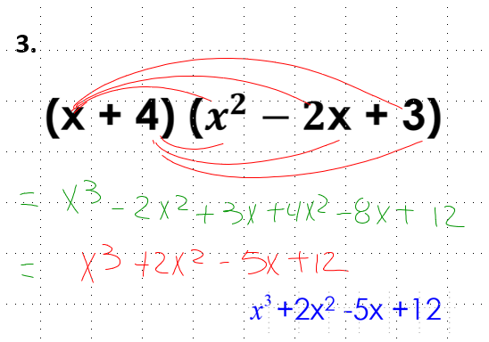
CHECK!

Slide 29
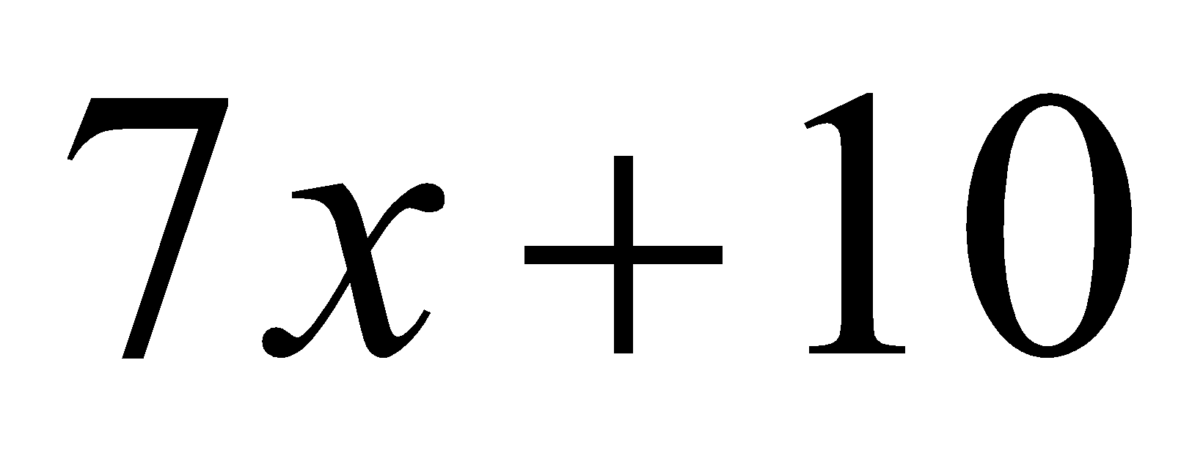
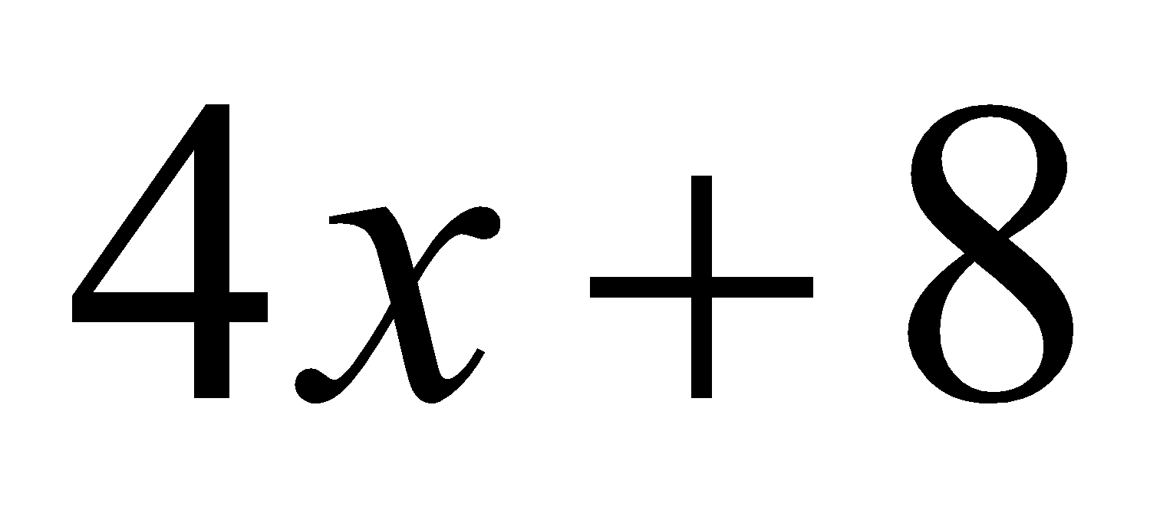
4. Find the area of the rectangle.

Slide 30
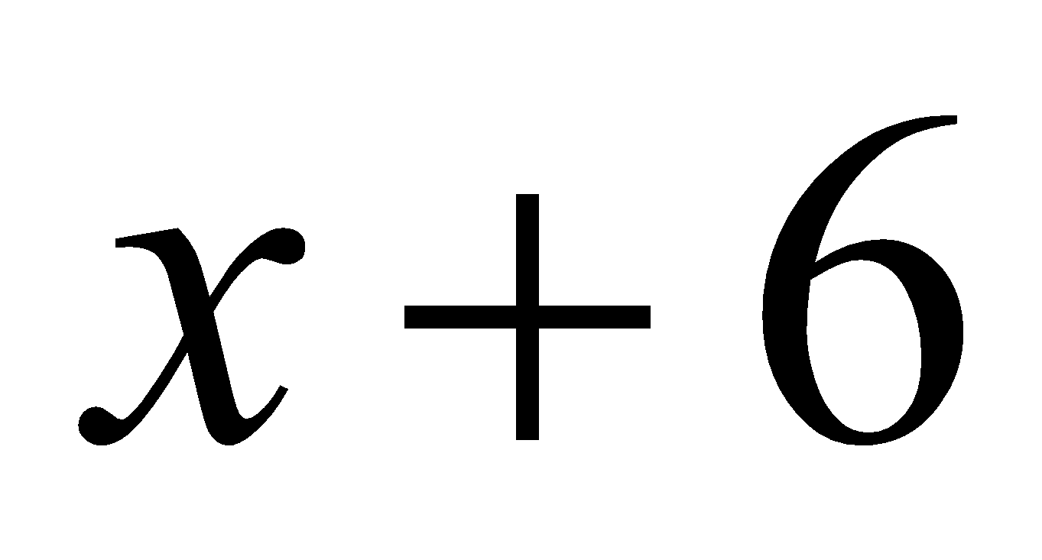
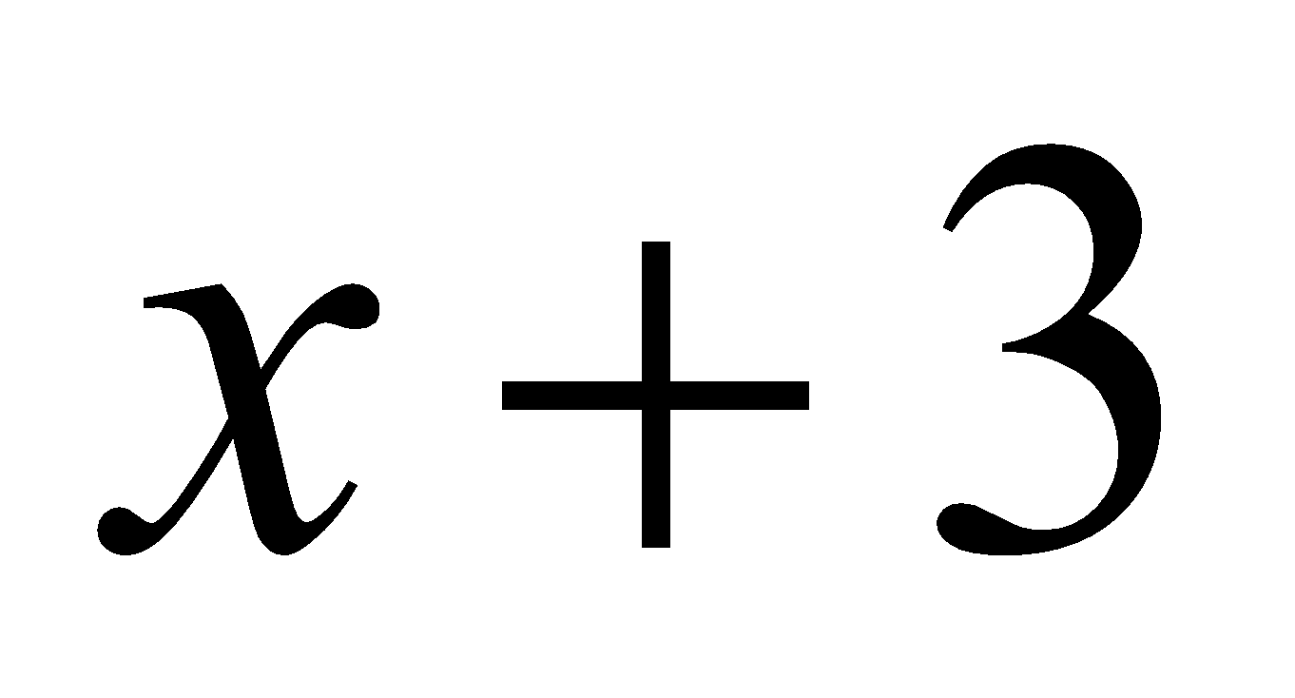
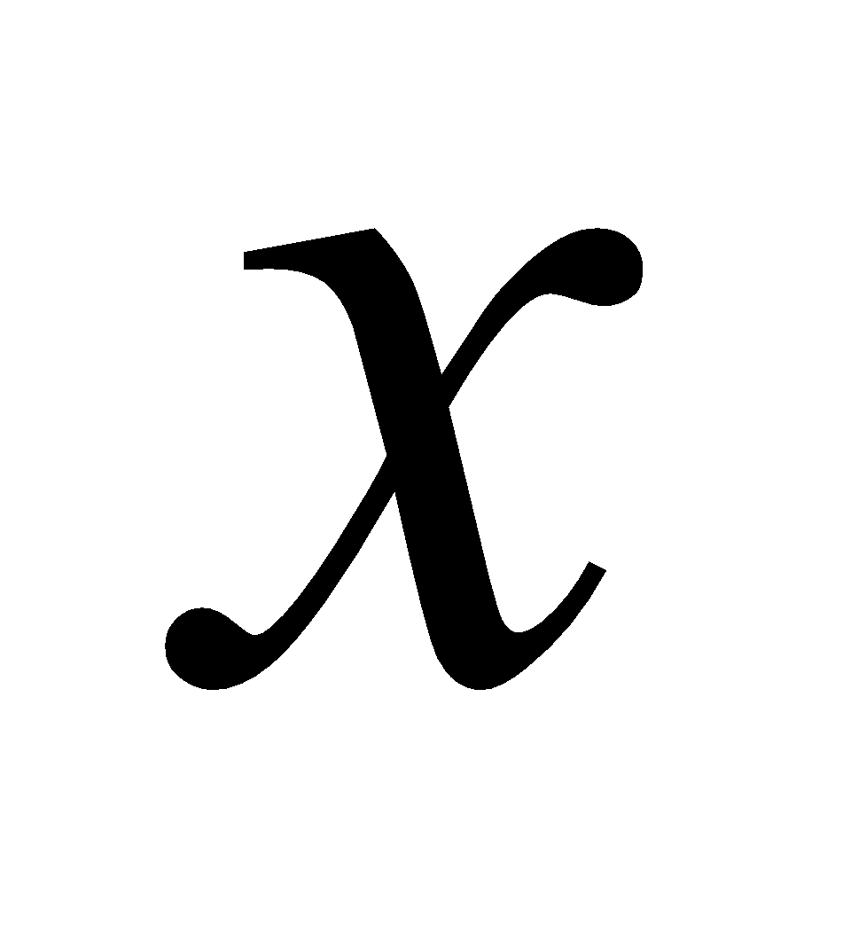
5. Find the volume.

Slide 32
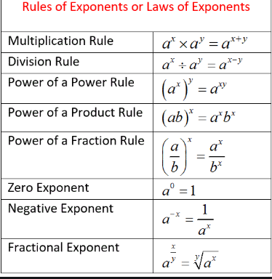
TAKE A
PIC
AND
REVIEW

Slide 33
CW/HW Unit packets page 1c all, Even only and pages 3 & 4(even)

Slide 34
Sponge 2/5/2020 (Wednesday)
Complete the handout!

Slide 35
Whole group practice! NOT IN ORGANIZER! Classify each of the polynomials by DEGREE and # of Terms …

Slide 36
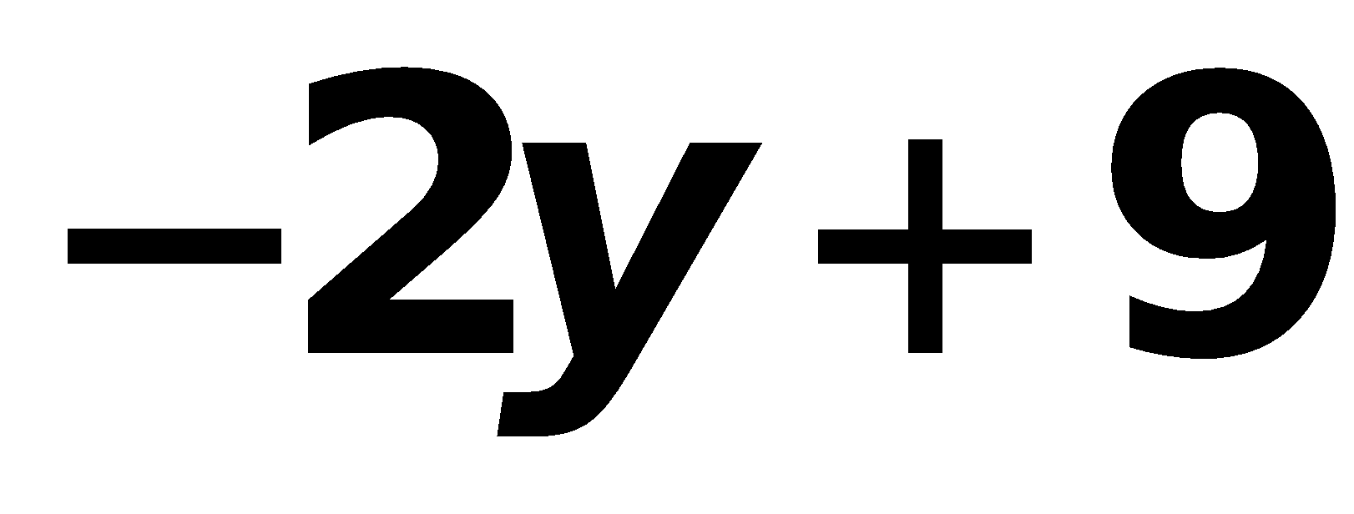
EX. 1 :
Linear
Degree Name: # of Terms Name:
Leading Coefficient:
Binomial
-2

Slide 37
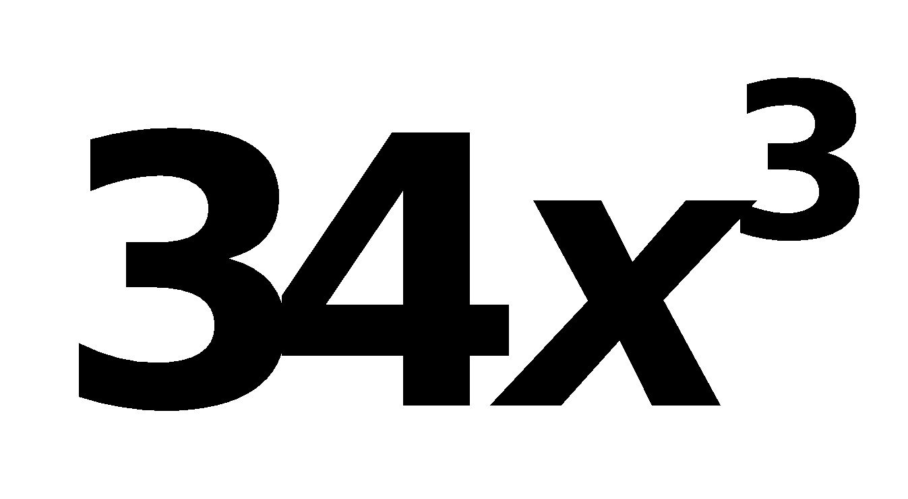
EX2.
Degree Name: # of Terms Name:
Cubic
Monomial
34
Leading Coefficient:

Slide 38
EX3.
Quadratic
Degree Name: # of Terms Name:
Leading Coefficient:
Binomial
4

Slide 39
EX4.
Cubic
Degree Name: # of Terms Name:
Leading Coefficient:
Trinomial
1

Slide 40
Part 2 : Whole group practice continued! Copy each.

Slide 41
Andddddd…….SOME MORE!!!
Copy each.
#1
3x² + x + 2

Slide 42
2.
x² + 2x – 2

Slide 43
10x – 3

Slide 44
4.
3a² + 10a – 8a² + a
– 5a² + 11a

Slide 45
5.
3x² + 2x – 4 – 2x² – x + 1
x² + x – 3

Slide 46
#6
Subtracting Polynomials
Subtract.
(–10x² – 3x + 7) – (x² – 9)
Rewrite subtraction as addition of the opposite.
(–10x² – 3x + 7) + (–x² + 9)
(–10x² – 3x + 7) + (–x² + 9)
Identify like terms.
–10x² – 3x + 7
Use the vertical method.
–x² + 0x + 9
Write 0x as a placeholder.
–11x² – 3x + 16
Combine like terms.

Slide 47
#7 Draw it and think about it!!!
Given that two sides of a triangle are 2x and 5x-1, find the third side if the perimeter is 11x+4.
4x + 5

Slide 48
Take out a ½ sheet of paper!

Slide 49
Ex. 1

Slide 50
Ex. 2

Slide 51
Ex. 3

Slide 52
Ex. 4

