Slide 1
Happy Valentines Day! Sponge ☺
Pick up your Sponge off the desk near my desk.
4th block check roster for your seat # assigned ! ☺
I will like to give you helpful hints if you can settle down….

Slide 3
Welcome Back !! Sponge
Simplify each!
(2x – 9) - (x – 7)
(8y² +2) +(5 -3y²)
(-3a² + 5) - (-a² + 4a – 6)
(2m – 8m² – 3) + (m² + 5m)
(4x² – 7x + 2) + (-x² + x -2)

Slide 4
Unit 2 Continued COMBING FUNCTIONS

Slide 5
Check!
x – 2
5y² +7
-2a² - 4a +11
-7m² +7m– 3
3x² – 6x

Slide 6
Guided Notes : Functions and Relations
Relation: Any set of ________ that has an _______ Ex. (x, y)
Function: A ________ such that every single _______ has exactly __________.
**Never ___________________________ **

Slide 7
Function Notation
Function notation is a way to ______
__________It is pronounced __________
f(x) is a fancy way of writing in an
_____________.
Example: y = 2x + 4 is the same as
_______________________

Slide 8
Combining Functions

Slide 9
Example #1 Given the functions, find the following.

Slide 10
Example #2 Given the functions, find the following.

Slide 11
Example #3 Given the functions, find the following.

Slide 12
Your turn, complete Examples #4 &5

Slide 13
Now… #’s 6 7 & 8 (Wake up and smile you’ve got this!☺ )
$${Given f\left(x\right)=5x}^{2}−9x+2$$
$${Given g\left(x\right)=x}^{3}+3x−8$$
$${Given h\left(x\right)=−2x}^{2}+1$$
$$Given k\left(x\right)=4x−3$$

Slide 14
Function Composition
Fancy way of performing SUBSTITUTION
The key idea in function composition is that the input of the function is not always a numerical value, instead, the input can also be another function.

Slide 15
Prt1: Function Composition
Function notation: f(x)
This DOES NOT MEAN MULITPLICATION.
Ex1. Given f(x) = 3x - 1, find f(2).
Substitute 2 for x and evaluate.
f(2) = 3(2) - 1 = 6 - 1 = 5

Slide 16
$${Given h\left(x\right)=−2x}^{2}+1$$
$${Given f\left(x\right)=5x}^{2}−9x+2$$
#12 Guided Notes Find h(2)- f(-1)

Slide 18
Find h(3) + g(-4)
#9 on Guided Notes Your turn!

Slide 19
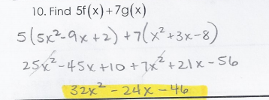
Now you finish, #’s 10, 11, &13… (7 min)
Check #10

Slide 20
Check #11

Slide 21
Check #13

Slide 22
Now don’t forget Pascals Triangle! (Do #’s 14&15)

Slide 23
HW is #’s 1-10 if you think you need it. I will display the answers on my website.

Slide 24
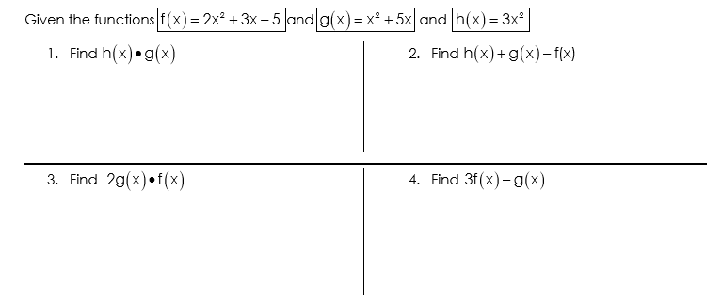
TUESDAY’S SPONGE (These problems or in Monday’s Guided Notes).
Guided Notes Handout from Monday (7-10)all

Slide 25
Check!

Slide 26
Composition in the Real World
You often use composite functions when you are evaluating expressions on a calculator.
Computer coding must be efficient, so programmers will compose functions to speed up computer programs and processes.

Slide 27
Prt.2 Composition of Functions Take Notes!! Notebook paper

Slide 28
Let’s practice “Substitution” before the “real deal” comes….☺

Slide 29
EX1.
Given g(x) = x² - x, find g(-3)
g(-3) = (-3)² - (-3)
= 9 – (-3)
= 9 + 3 = 12
Therefore, g(-3) = 12

Slide 30
Example #2

Slide 31
EX3 ( your turn again)
Given g(x) = 3x - 4x² + 2, find g(5)
g(5) = 3(5) - 4(5)² + 2
= 15 - 4(25) + 2
= 15 - 100 + 2
= -83
Answer: g(5) = -83

Slide 32
Now this one! Go on… ☺
Given f(x) = x - 5, find f(a+1)
f(a + 1) = (a + 1) - 5
= a+1 - 5
f(a + 1) = a – 4 (the answer)

Slide 33
Part 2
Is still just fancy substitution!
We are only “substituting” in another function!function

Slide 34
Copy: The notation.
g(f(x))
We read it ‘g of f of x’
or
or f(g(x))
We read it ‘f of g of x’

Slide 35
Additional Notation….
f(g(x)) = (f ∘ g)(x)
g(f(x)) = (g ∘ f)(x)

Slide 36
Ex1 Given f(x) = 2x + 2 and g(x) = 2, find f(g(x)).
Given f(x) = 2x + 2 and g(x) = 2, find f(g(x)).
1st Start on the inside. f(g(x))
g(x) = 2, so replace it.
2nd f(g(x)) = f(2) =
= 2(2) + 2 = 6
6 is my final answer

Slide 37
Ex2.
Given g(x) = x - 5 and f(x) = x + 1, find f(g(x)).
1st g(x) = x - 5 so replace it inside f(x).
2nd f(g(x)) =
3rd Simplify =(x - 5) + 1
= x - 4
Final answer f(g(x)) = x - 4.

Slide 38
Ex3. Given g(x) = x - 5 and f(x) = x + 1
Now let’s find g(f(x)).
Well f(x) = x + 1 so replace it inside function g!
We know g(x) = x - 5
Therefore = (x + 1) - 5 = ??x
= x - 4

Slide 39
Last one with me! Example #4

Slide 40
Example #5 (you try)
(Composition)

Slide 41
Ex6. You try!
Given f(x) = x² + x and g(x) = x - 4, find f(g(x))
f(g(x)) = f(x - 4)
=(x - 4)² + (x - 4)
= x² - 8x+16 + (x – 4)
= x² - 7x +12
12

Slide 42
Collaborative Groups (Function Composition Matching Activity)
1st Choose a team lead.
Cut along the dotted lines of the orange sheet.
Collaborate to match #’s 1-9.
Record answers on Answer sheet provided.
Attach work from each member to the answer sheet.
Discard the cut outs once done!
HW- Handout on Desk (1-10all)

Slide 43
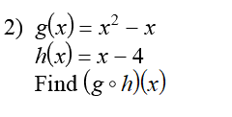
Sponge (Check Rosters &Turn in HW)

Slide 44
Check!

Slide 45
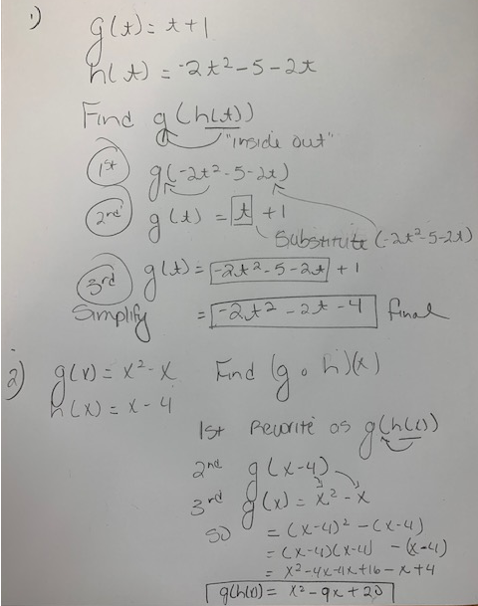

Slide 46
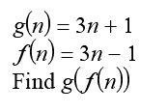
White Board “Quick Review” #1

Slide 47
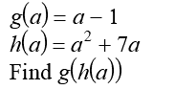
White Board “Quick Review” #2

Slide 48
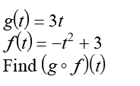
White Board “Quick Review” #3

Slide 49
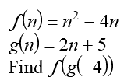
White Board “Quick Review” #4

Slide 50
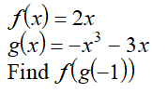
White Board “Quick Review” #5

Slide 51
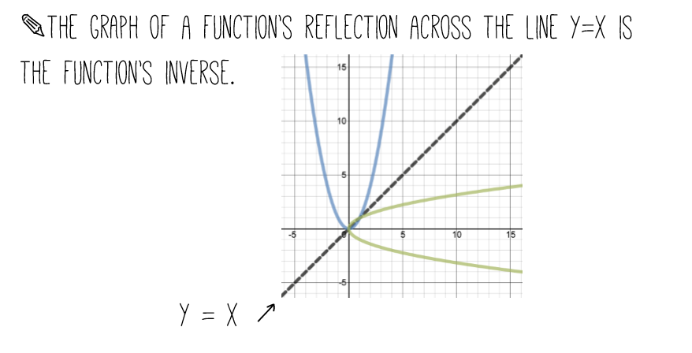
Copy Notes!
A visual
representation!
Do not copy!

Slide 52
Example

Slide 54
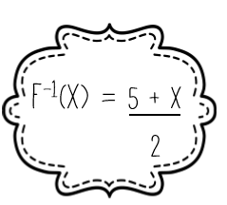
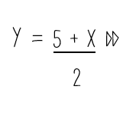

Slide 55
Example 2
Ex1 given f(x) = x + 5.
1st Substitute for f(x).
y = x + 5.
Then switch x and y.
x = y + 5
Now solve for y.
x - 5 = y (this is your inverse equation)
Final Answer:
f⁻¹(x) = x - 5

Slide 56
Your turn!
Given h(x) = -3x + 9, find it’s inverse.
y = -3x + 9
x = -3y + 9
x - 9 = -3y
$f^{−1}\left(x\right)=\frac{x−9}{−3}$

Slide 57
Exploring/Discovering/Drawing Conclusions/Modeling/I etc.…You name it….. we’re doing it!☺ Inverses Functions Activity.
Choose a team lead!

Slide 58
1st A Flash Back to Algebra1/Geometry…
What will be the inverse of this relation?
x | y
4 | 3
-3 | 1/9
3 | 7

Slide 59
2nd Another Flash Back ☺
What is the slope of y= 3x-2 ?
What is the y-intercept of y= 3x-2 ?

Slide 61
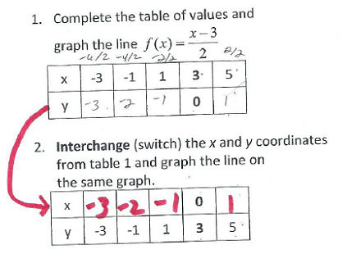
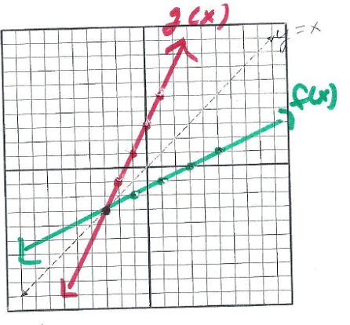

Slide 63
Conclusion from Activity!
Perform composition both ways !!!
f(g(x)) = x and g(f(x))= x
Both must equal “x”.

Slide 64
Let’s Recap and Practice! Find the inverse. Find the inverse of $y= \sqrt{2x−4}$

Slide 65
Check !

Slide 66
Let’s Practice! Find the inverse.
Given f(x) = x² - 4
y = x² - 4
x = y² - 4
x + 4 = y²

Slide 67
#2 Continued….
x + 4 = y²
$$y^{−1}=\sqrt{x+4}$$

Slide 68
#3 Are the two functions inverses?
f(x) = -2x+4 and g(x)= $\frac{1}{2}x$+2

Slide 70
#3 Check f(g(x)) given f(x) = -2x+4 and g(x)= $\frac{1}{2}x$+2

Slide 71
HW- Unit Packets page 18, #’s 4-14 even (separate notebook paper)

Slide 72
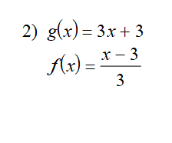
Sponge (Turn in HW) Are the two functions inverses?

